Slide 1
AI Career Path

Slide 2
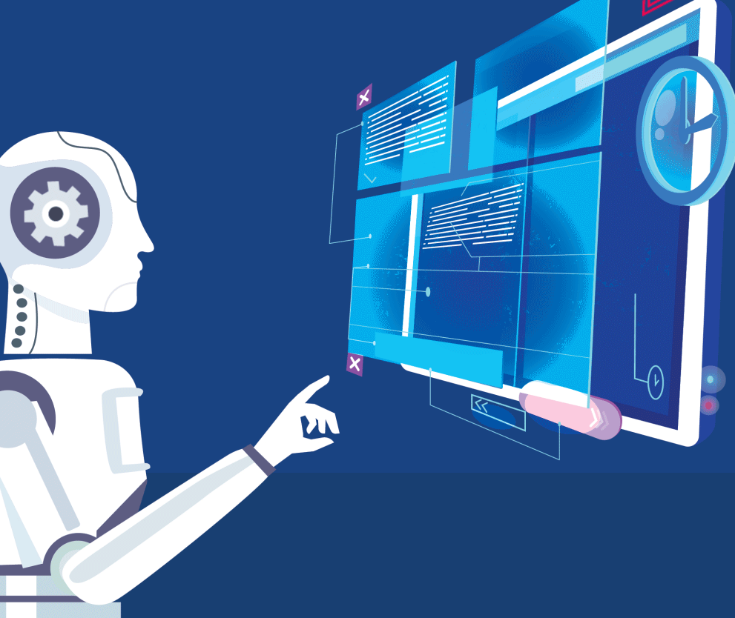
What is AI?

Slide 3
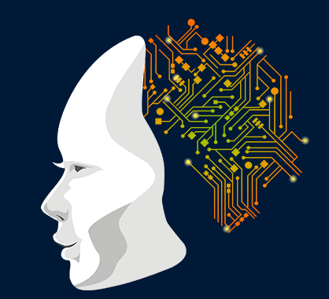
Artificial Intelligence
Artificial Intelligence (AI) is a branch of Science which deals with helping machines finding solutions to complex problems in a more human-like fashion.

Slide 4
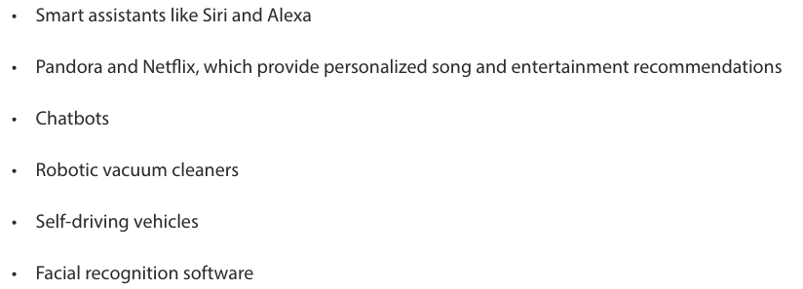
Examples of artificial intelligence include:

Slide 5
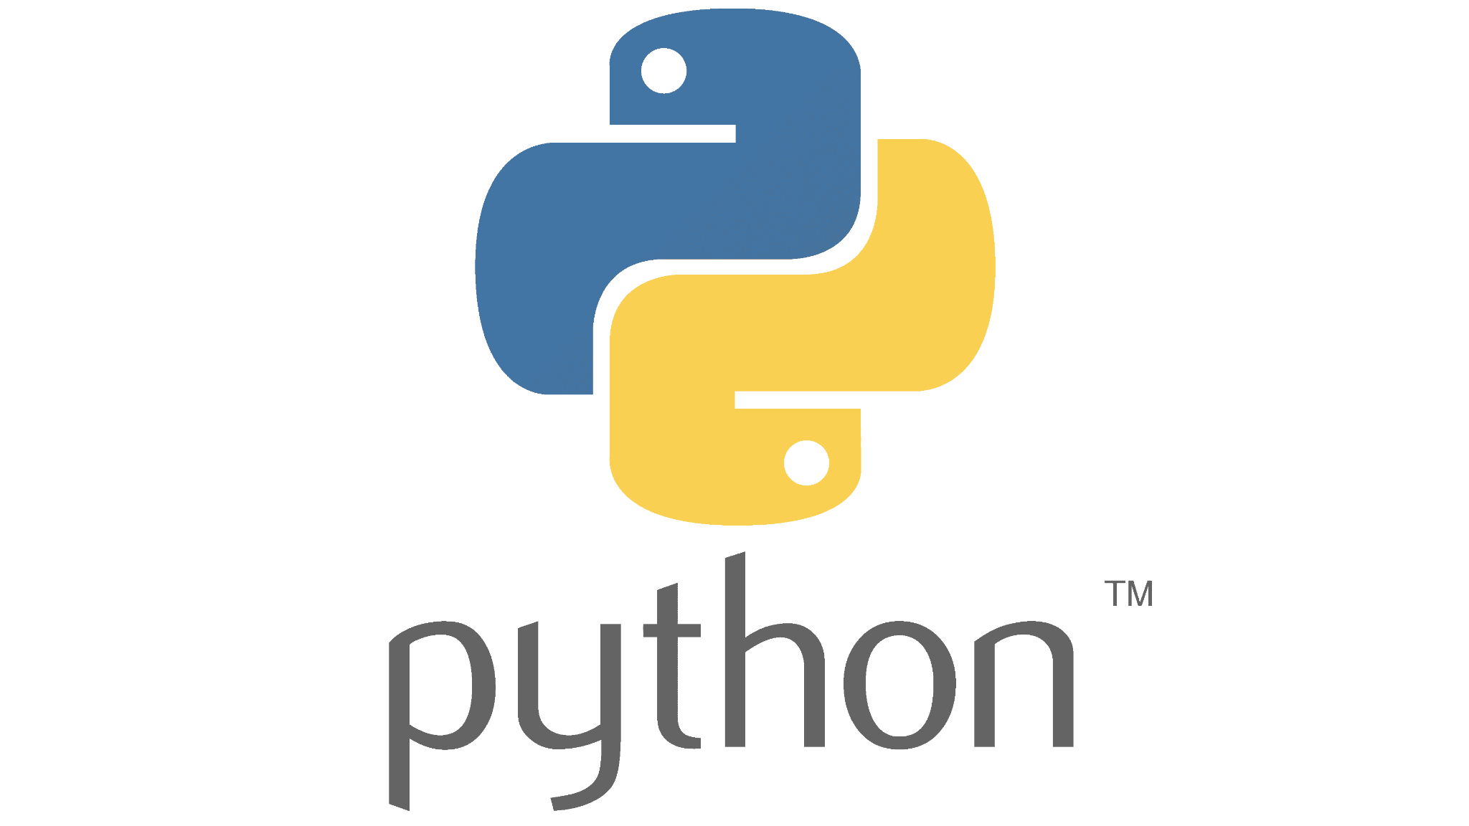


Skills an AI Professional Needs
Python
C/C++
Matlab

Slide 6
Career Paths in Artificial Intelligence
Data Analytics: Finding meaningful patterns in data by looking at the past to help make predictions about the future.
Natural Language Processing: that deals with text and speech processing.
Researcher: AI research, and Discover ways to advance AI technology.
Research Scientist: Expert in applied math, machine learning, deep learning, and computational stats.
Software Engineer: Develop programs on which AI tools function
AI Engineer: Build AI models from scratch and help product managers and stakeholders understand results.
Data Mining and Analysis: Finding anomalies, patterns, etc. within large data sets to predict outcomes.
Machine Learning Engineer: Using data to design, build, and manage ML software applications.
Data Scientist:Collect, analyze, and interpret datasets.
Business Intelligence (BI) Developer: Analyze complex data sets to identify business and market trends.
Big Data Engineer/Architect: Develop systems that allow businesses to communicate and collate data.

Slide 7
Most Common AI career in Nepal
NLP Engineer
Computer Vision Engineer
Research Engineer
Machine Learning Engineer
Deep Learning Engineer
MLOps Engineer
AI Engineer

Slide 8
Companies Currently Hiring AI Positions
MIT Lincoln Laboratory — Artificial Intelligence Researcher
Walmart — Data Scientist
Amazon — Research Scientist
Nike — Lead Artificial Intelligence/Machine Learning Engineer
IBM — Conversational Artificial Intelligence Engineer
Samsung Electronics America — Machine Learning Engineer
Warner Bros. Entertainment — Data Scientist
Fidelity Investments — Data Scientist
PepsiCo — ML Engineer

Slide 9







Companies Currently Hiring AI Positions in Nepal

Slide 10
Artificial Intelligence Salaries in Nepal per month
Internships: 10k-15k (India: 32k-40k)
AI Fresher Engineers: 30-40k (India: 35k-60k)
AI Engineers with 1yr exp: 45k-60k (India: 1lakhs-1.5lakhs)
AI Engineers above 3 years exp: above 1 lakhs (India: above 3 lakhs)

Slide 11
Artificial Intelligence Salaries
According to Indeed, “the average salary for ‘artificial intelligence’ ranges from approximately $93,451(1,18,95,321.72npr) per year (9,91,276 npr per month) for research engineers to $150,683(1,91,80,348.66npr) per year (15,98,362npr/month) for machine learning engineers.”
The average annual base pay for artificial intelligence salaries in the United States is $105,669(1,34,50,543.61npr), according to Glassdoor.
According to Talent.com, the average artificial intelligence salary is $140,000 per year. Entry positions start at $110,063, and most experienced employees can make up to $210,000 per year.

Slide 12
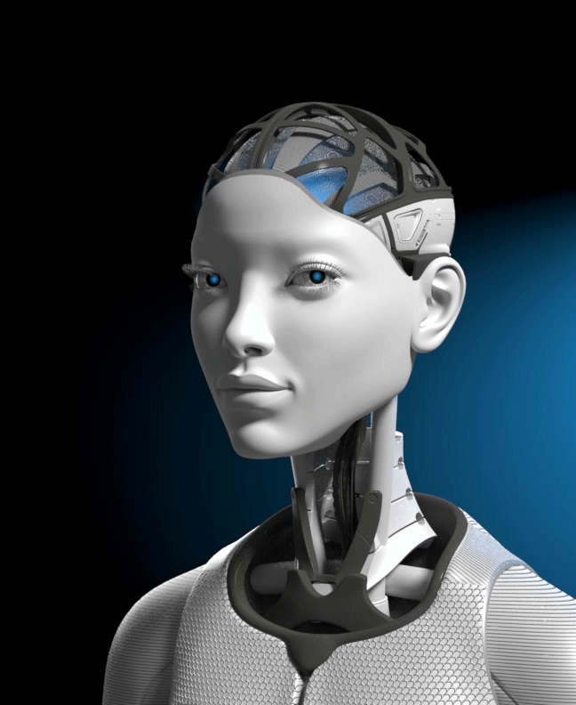
Future is AI..
It has a wide future scope..

